Slide 1
Comparison of RIM, N2, AIB off food beahvior

Slide 2
Data used
1. for combineation
2. for individual video comparison

Slide 3
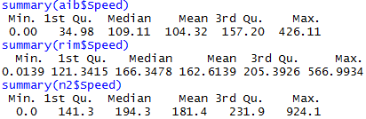
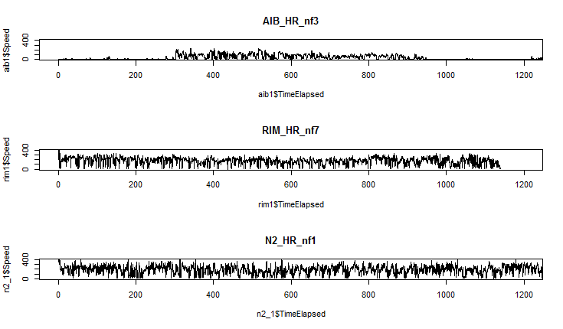
Summary of speed
Combine
Individual

